Slide 1

PROJECT PRESENTATION
RELIABLE MEDICAL SUPPORT SYSTEM
Course Title: Software Engineering Sessional
Submitted By:
Abdul Owadud Raton(214033)
Md. Imon Hossain (214039)
Md. Mesbaul Alam (214040)
Course Teachers:
Dr. Momotaz Begum
Professor, Dept. of CSE, DUET
Mr. Liton Islam
Assistant Professor, Dept. of CSE, DUET
Department of Computer Science and Engineering
Dhaka University of Engineering & Technology, Gazipur

Slide 2
INTRODUCTION
This project is an AI-assisted preliminary medical support system where patients describe their symptoms in plain language and receive a structured, non-diagnostic health assessment. It combines NLP, a medical knowledge base Data, retrieval-augmented generation (RAG), a large language model, and a rule-based safety layer into one full-stack web application.
2

Slide 3
OBJECTIVE
Let patients enter symptoms in free text and receive a structured AI-assisted assessment.
Detect emergency (red flag) symptoms independently of the AI, before any AI call
Ground AI responses in a real medical knowledge base data via RAG never let the AI invent facts
Make every assessment explainable: show why a condition or urgency level was suggested
Keep patient data private and every assessment strictly owned by the patient who created it
2

Slide 4
TOOLS AND MATERIALS
Frontend Backend
01
React 18
08
Python 3.11
02
TypeScript
09
SQLAlchemy2.0
03
Vite
10
JWT authentication, Argon2 password hashing
04
Tailwind CSS
11
PostgreSQL 16 + pgvector extension
05
React Router
12
spaCy+custom rule-based NLP
06
React Hook Form
13
Docker, Testing: pytest(backend), Vitest+ React Testing Library (frontend)
07
Axios
3

Slide 5
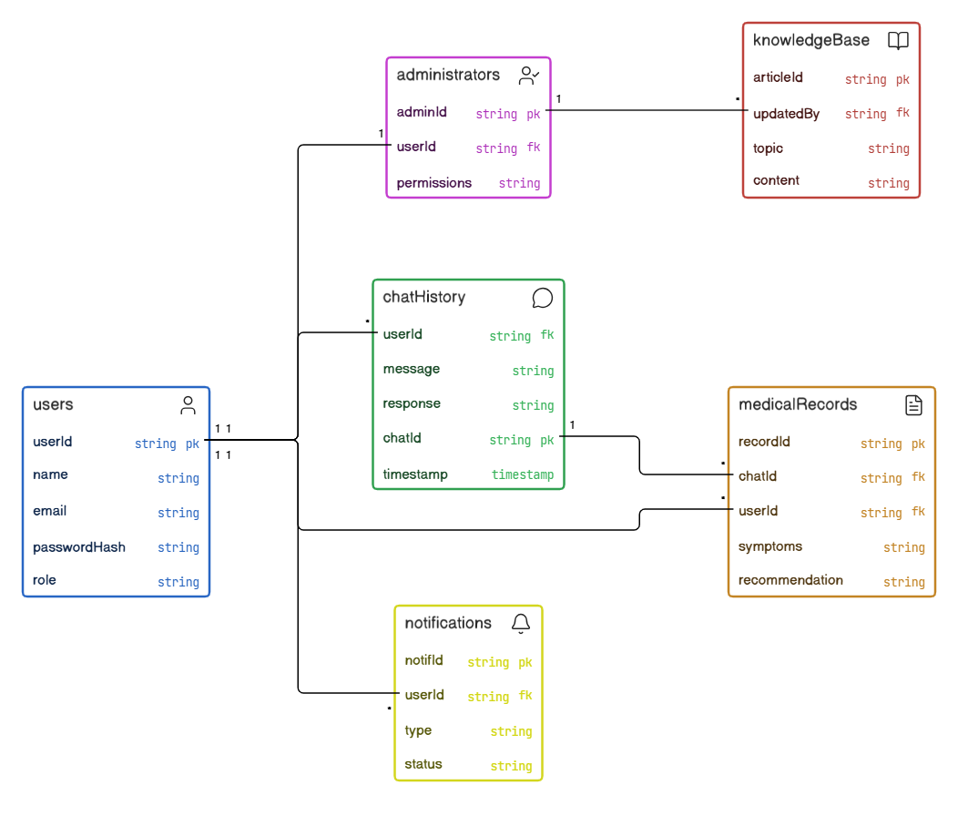
UML DESIGN
Reliable Medical Support System UML Design
Now, I will introduce to Reliable Medical Support System UML Design .
4

Slide 6
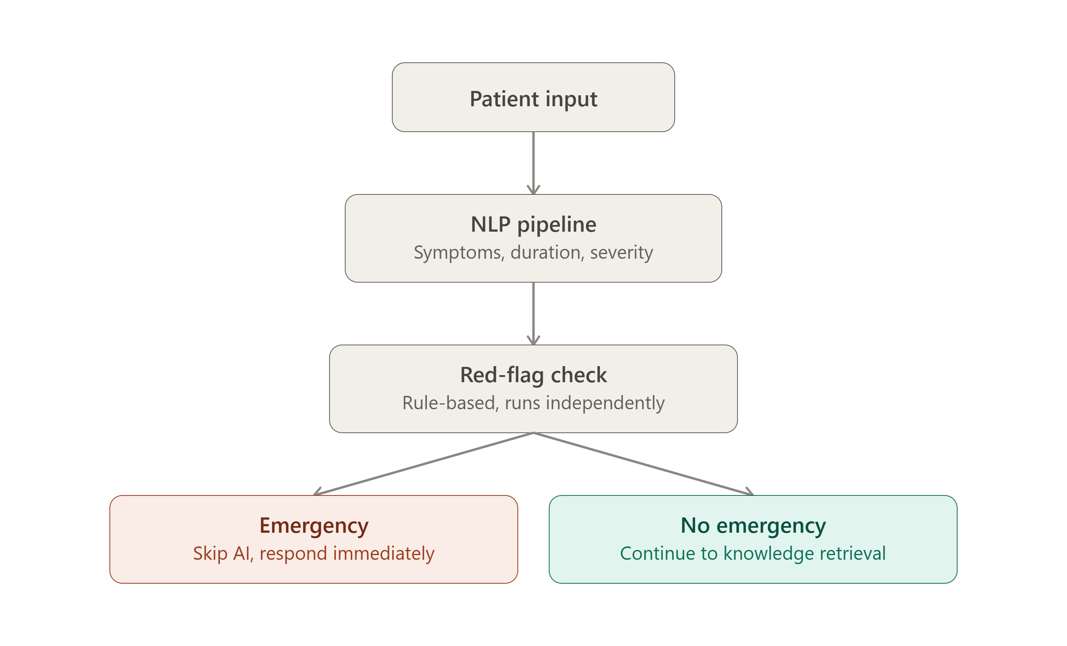
METHOD
OVERVIEW
AT a glance, we show assessment pipeline overview of Reliable Medical Support System
5

Slide 7
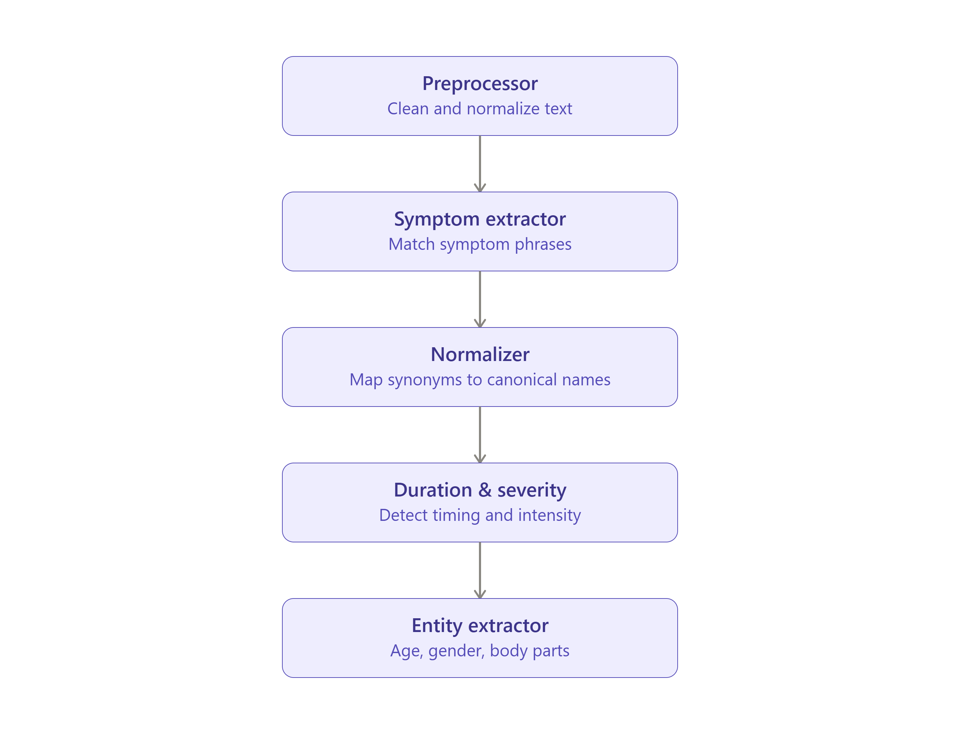
METHOD
NLP Pipeline
What happens next if you follow the "no emergency" path is shown here in a zoomed-in view the 5 steps within NLP:
6

Slide 8
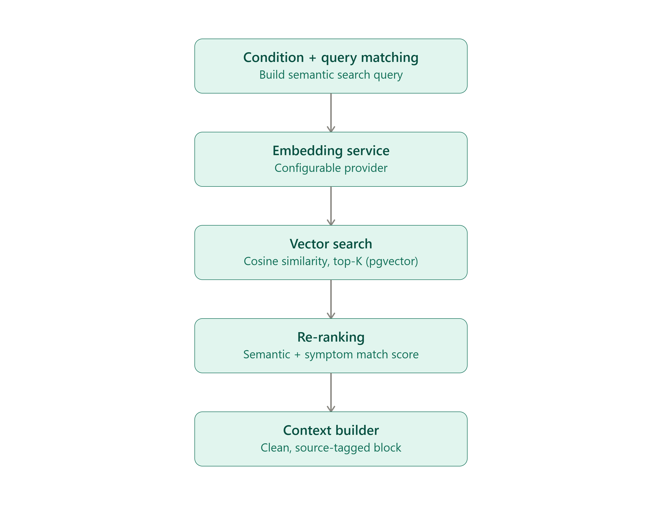
METHOD
RAG Pipeline
The knowledge base is then searched using the normalized symptoms derived from NLP; here are the five steps within RAG:
7

Slide 9
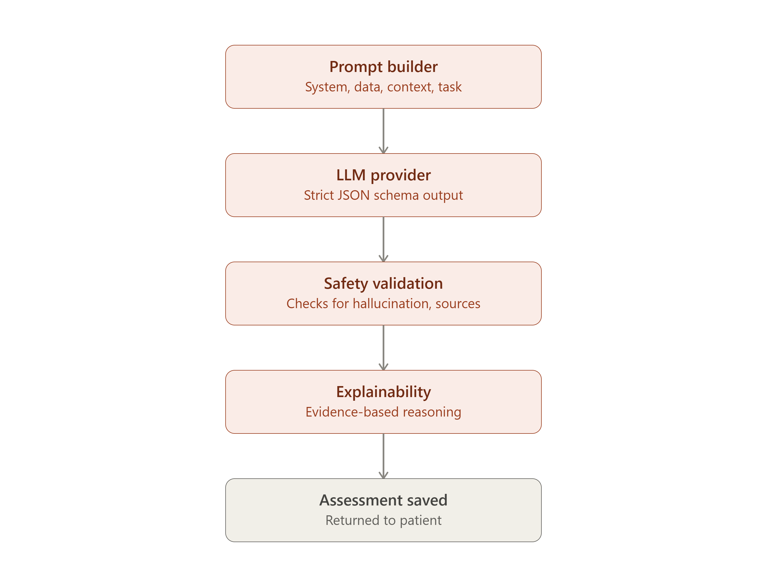
METHOD
LLM Pipeline
Now, this context is sent to the LLM, and then the final five steps are validated and explained.
8

Slide 10
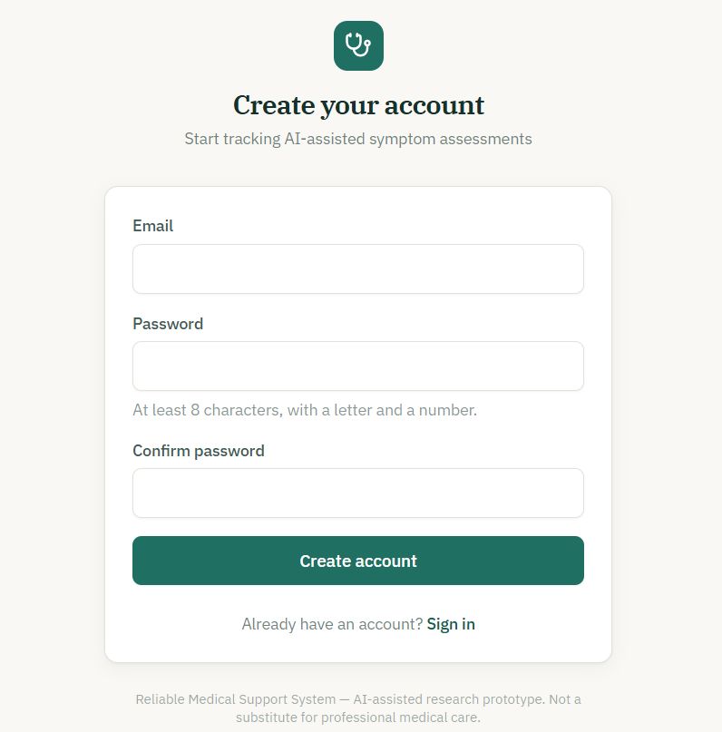
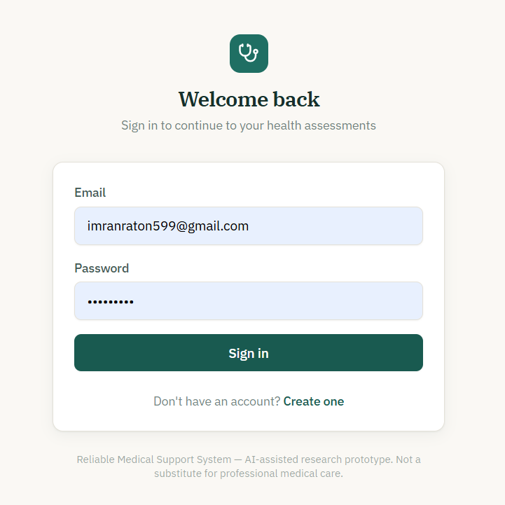
Project Skeleton
Create Account page and Login Page
First of all , If you are a new member, then you create a new account by your own Gmail address and password, and if you have an account just login by your Gmail and password
9

Slide 11
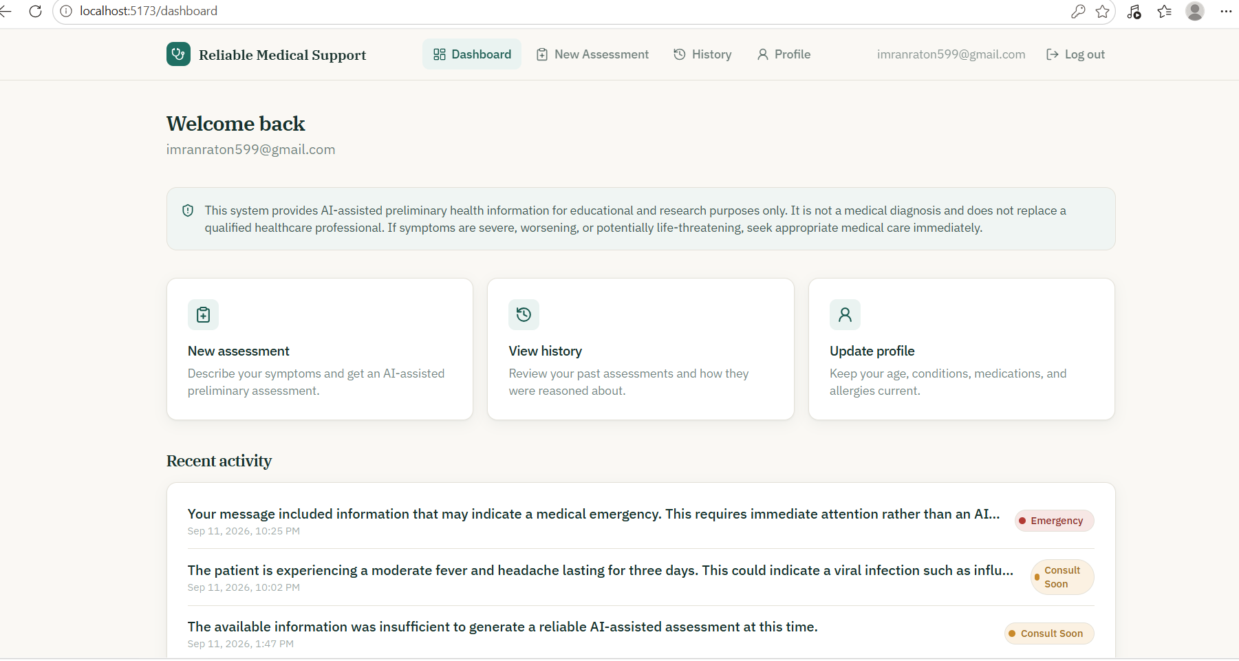
Project Skeleton
Dashboard
10

Slide 12
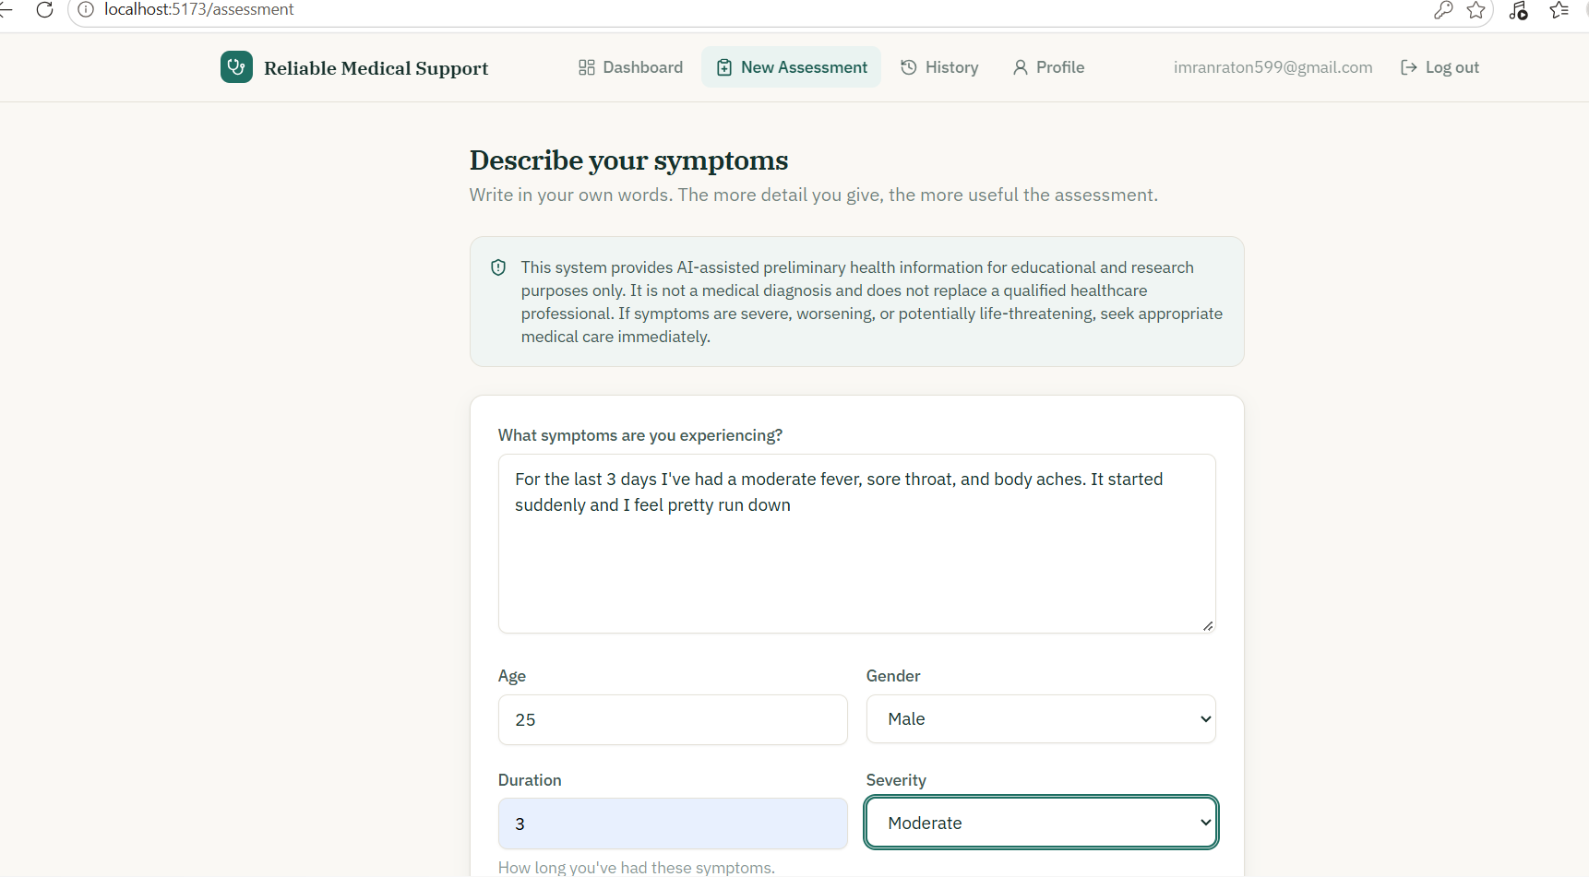
Project Skeleton
Prompt Symptoms and others Information
On the eighth day, I studied how the CNN model work.
11

Slide 13
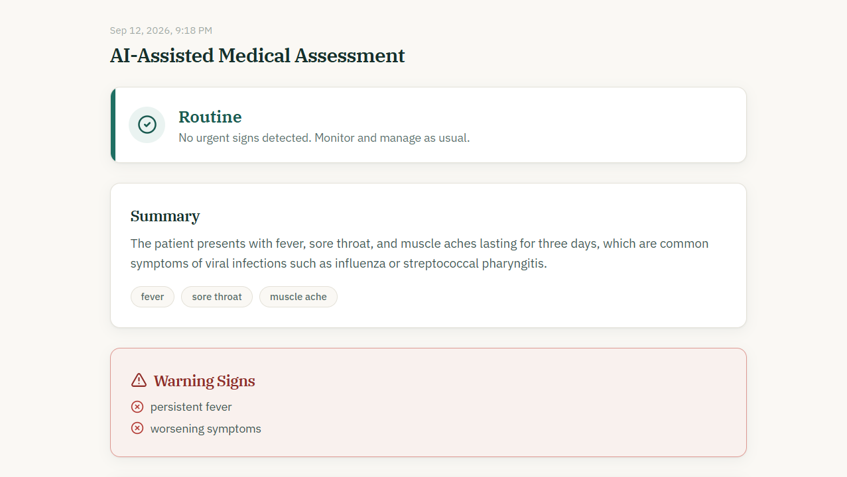
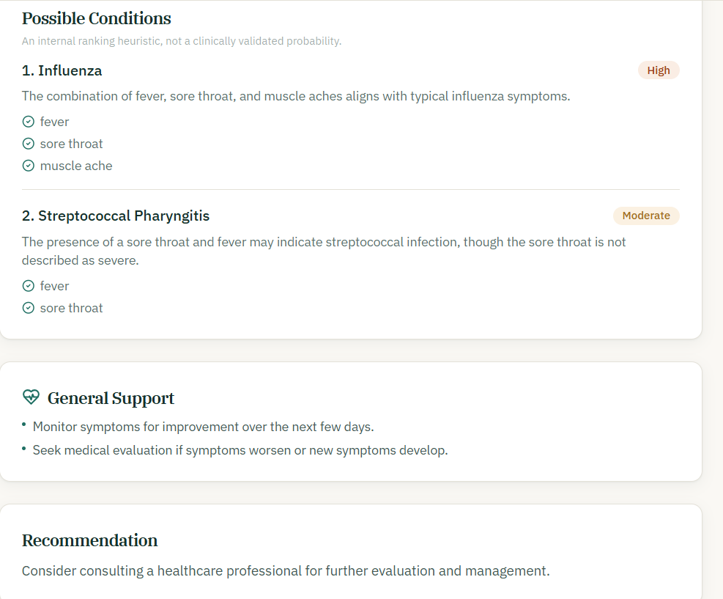
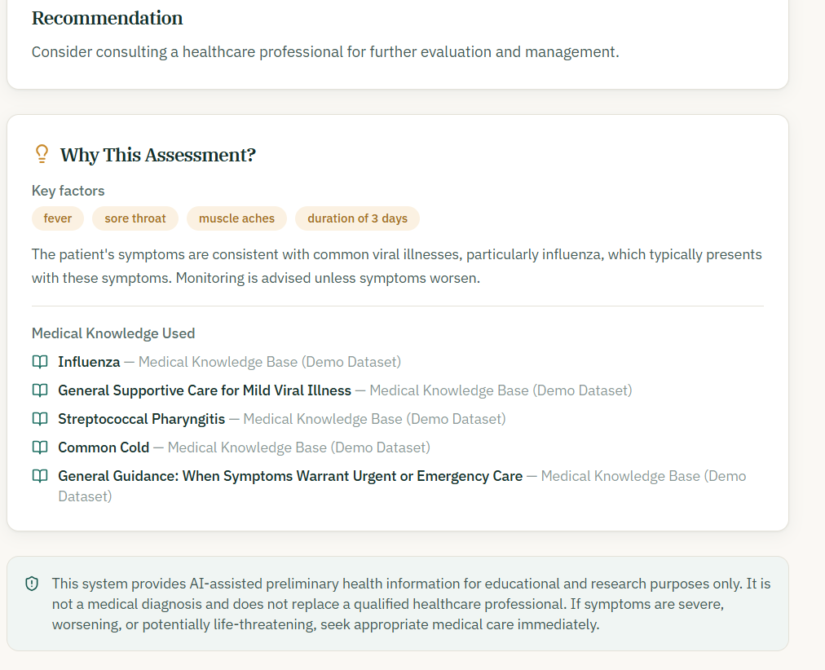
Project Skeleton
Disease Prediction and Suggestion
12

Slide 14
CONCLUSION
The system's main strength is that safety is enforced structurally rather than just through instructions to the AI emergencies can't be downgraded, and cited sources are always real, retrieved content rather than something the model invented. Its main limitation is that the medical knowledge base is a small demo dataset that isn't clinically validated, and it currently depends on a paid API key for the AI features to work fully. Future work would focus on expanding the knowledge base with validated clinical sources and supporting offline, self-hosted AI models.
13

Slide 15
Thank you for Attentions
Any Questions?

